Slide 1


Plant Here

Slide 2
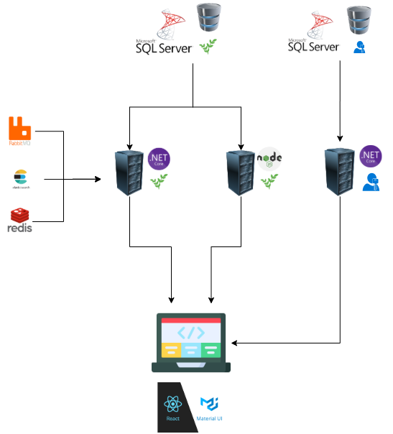
Proje Mimarisi

Slide 3
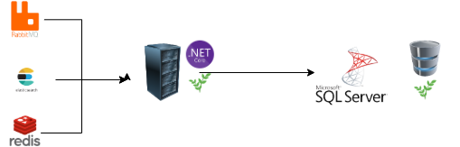
API de Kullanılan Teknolojiler (.NET PlantHere)
Onion Architecture
RabbitMQ (CAP)
CQRS ve MediatR
Elasticsearch
DDD
Redis (Distributed Cache)
Options Pattern
Decorator Pattern
Entity Framework (Code First)
Scrutor
xUnit ve Moq

Slide 4
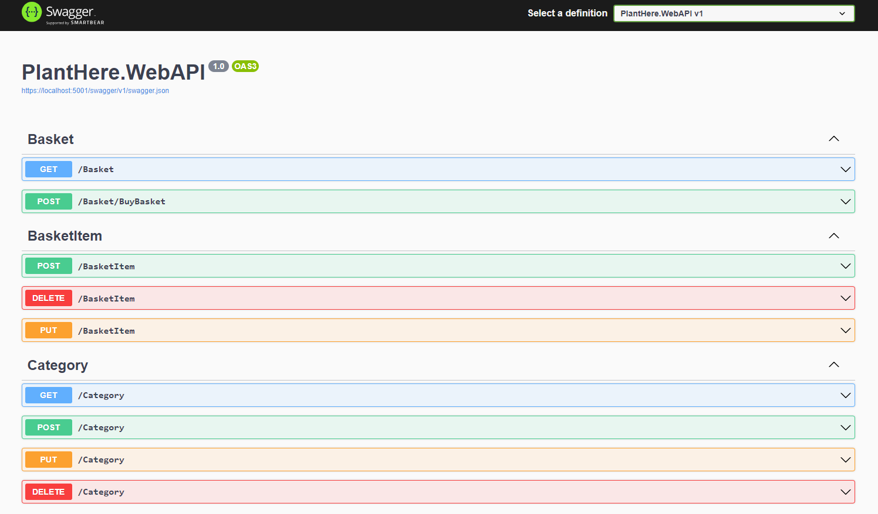
API İçeriği (.NET PlantHere)
https://localhost:5001/swagger/index.html
https://localhost:5001/cap

Slide 5

API de Kullanılan Teknolojiler(.NET AuthServer)
Onion Architecture
RabbitMQ (CAP)
CQRS ve MediatR
Entity Framework (Code First)
Options Pattern
(JWT) Symmetric Security Key

Slide 6
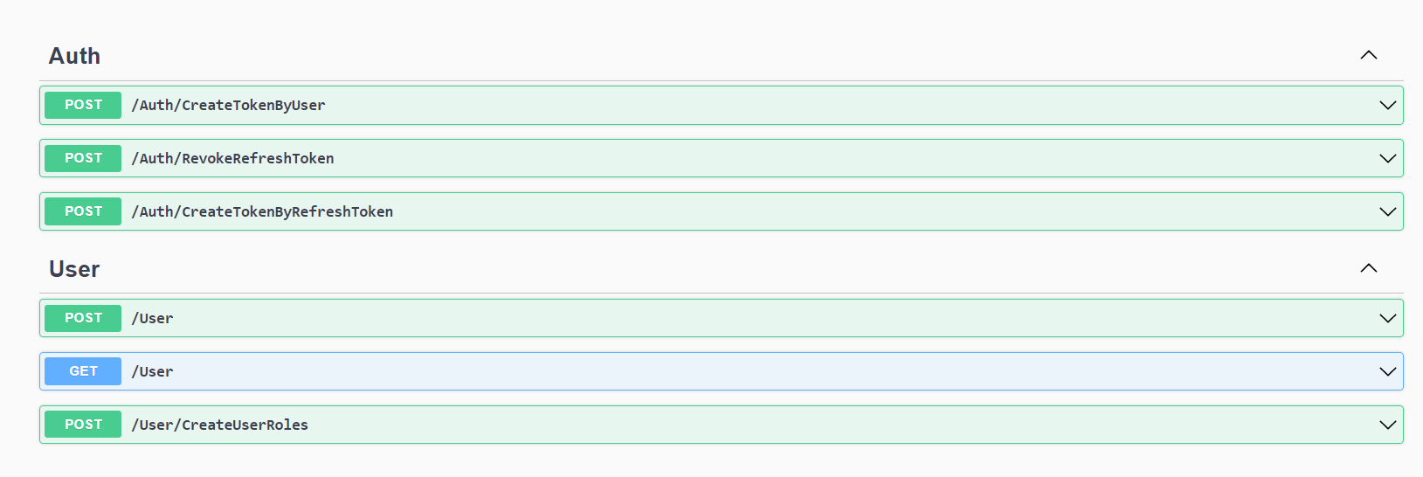
API İçeriği (.NET AuthServer)
https://localhost:5003/swagger/index.html
https://localhost:5003/cap

Slide 7

API de Kullanılan Teknolojiler (NodeJs PlantHere)
Onion Architecture
Express
Sequelize (Database First)

Slide 8
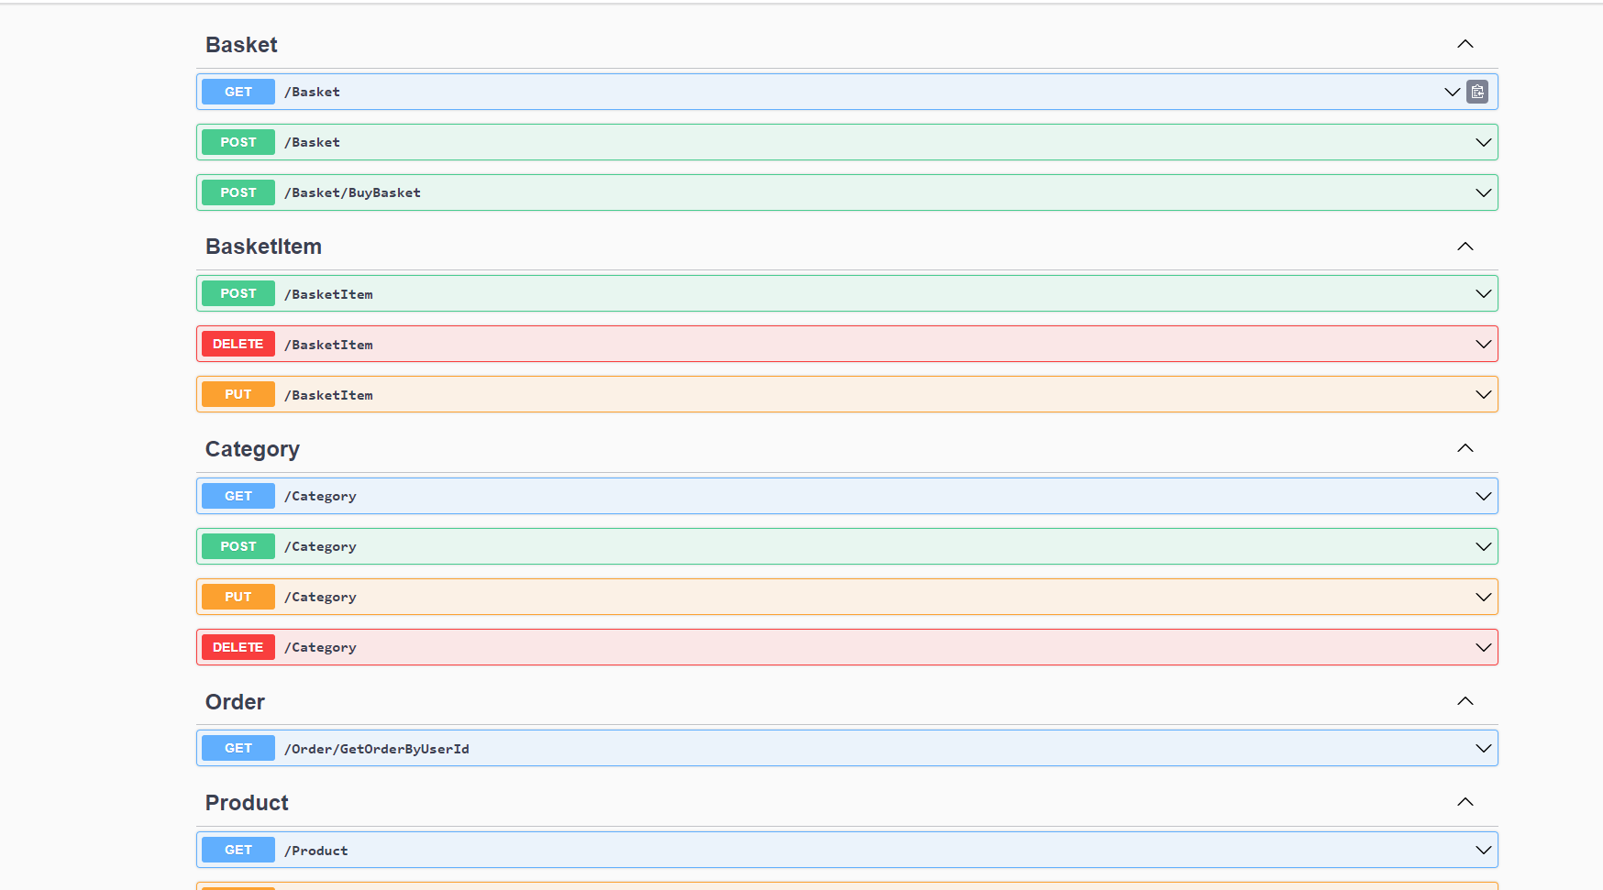
API İçeriği (NodeJs PlantHere)
http://localhost:4000/swagger/

Slide 9
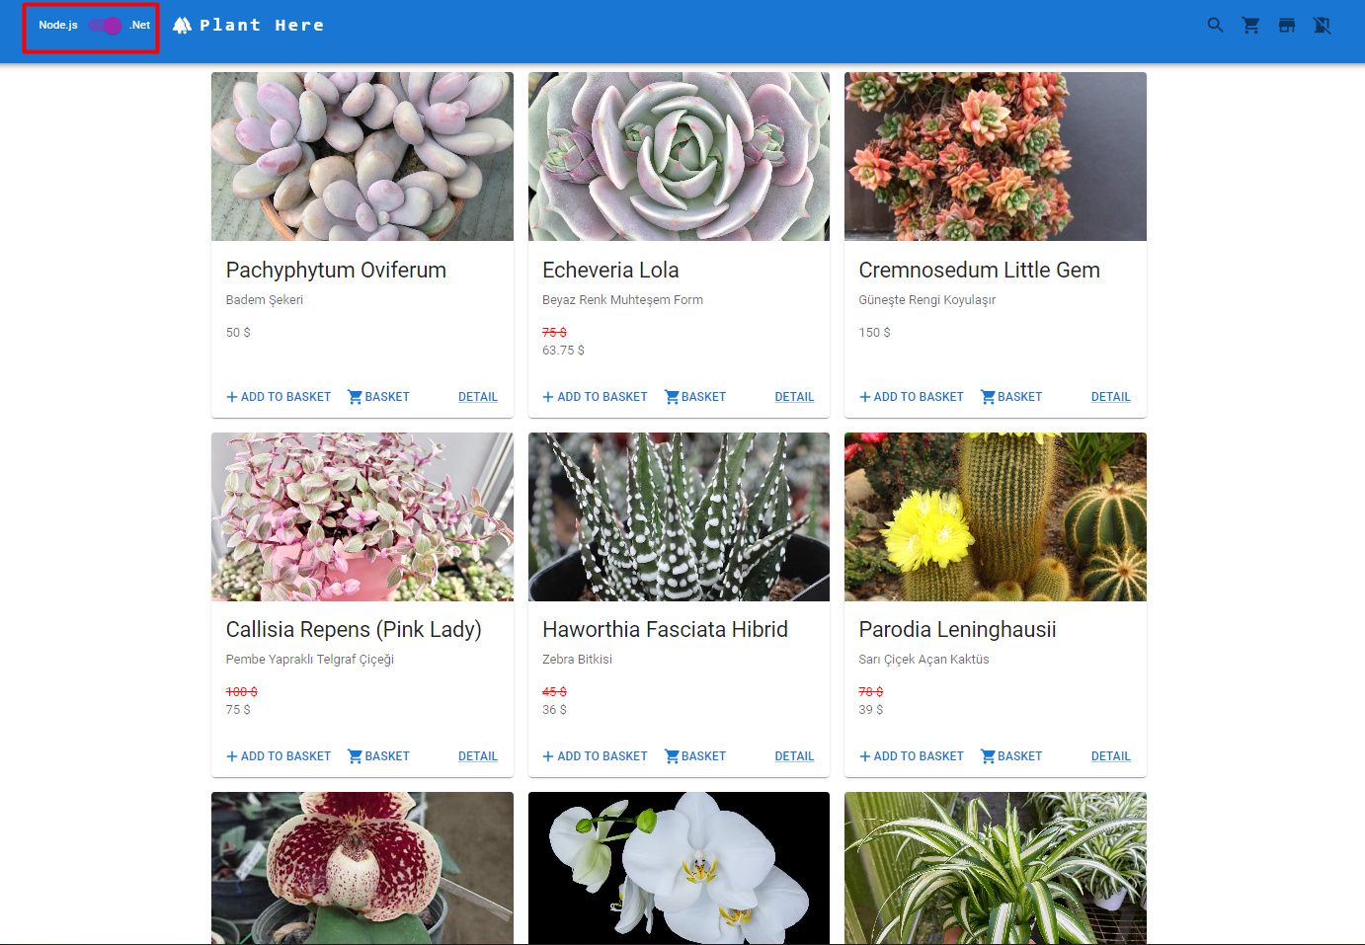
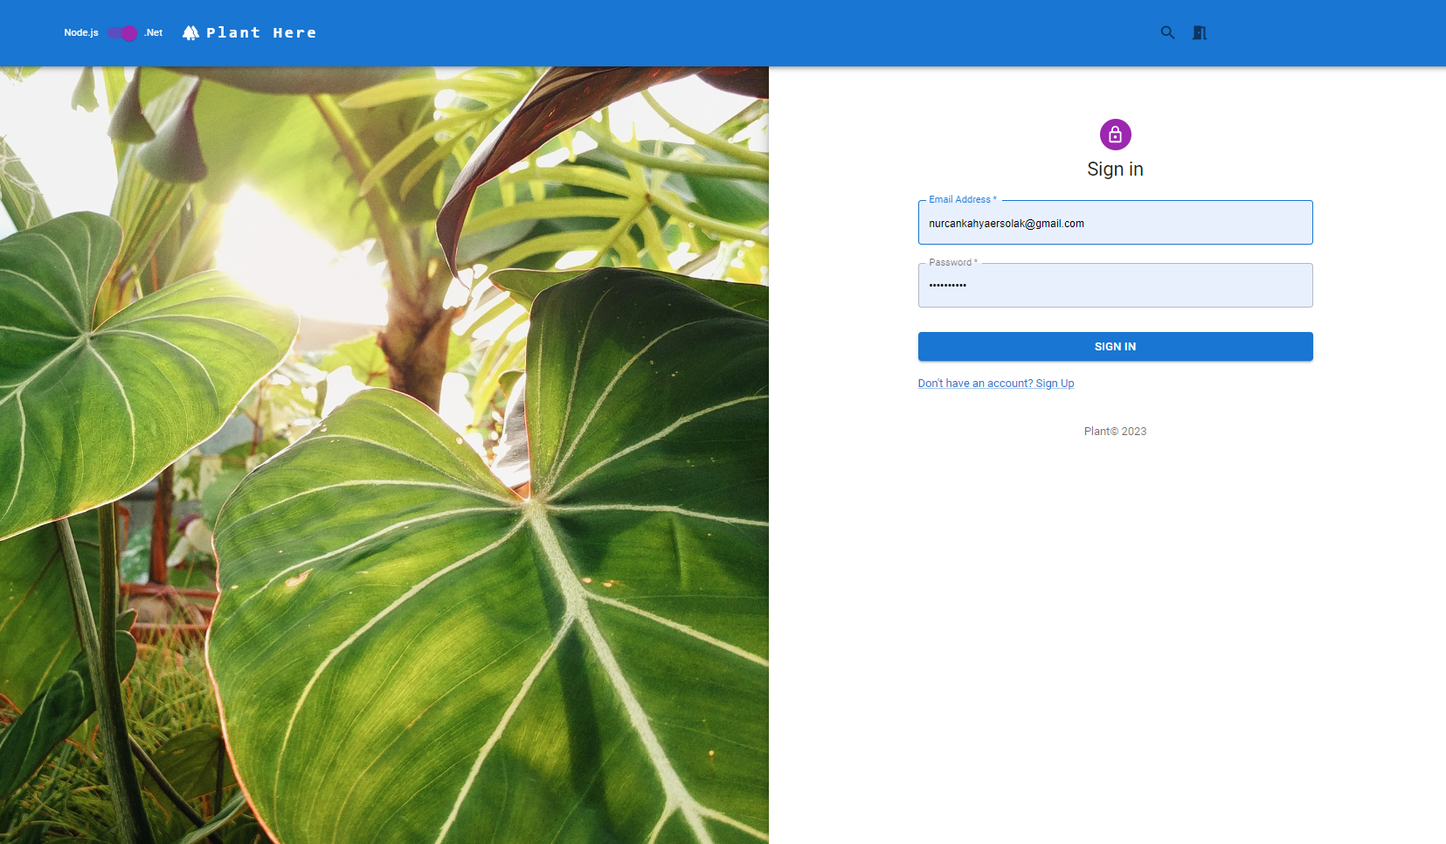
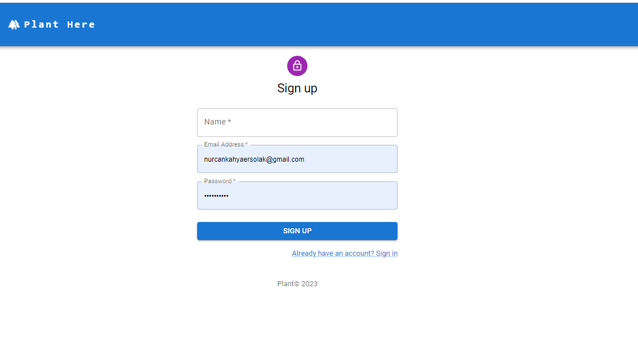
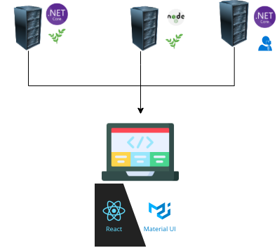
Projede Kullanılan Teknolojiler (Reactjs)
http://localhost:3000/

Slide 10




thank
you
Nurcan Kahya Ersolak
Nurcan.Ersolak@adesso.com.tr
+90 553 559 27 37

